Slide 1

An insight into adult physical activity behaviour in
Worcestershire

Slide 2


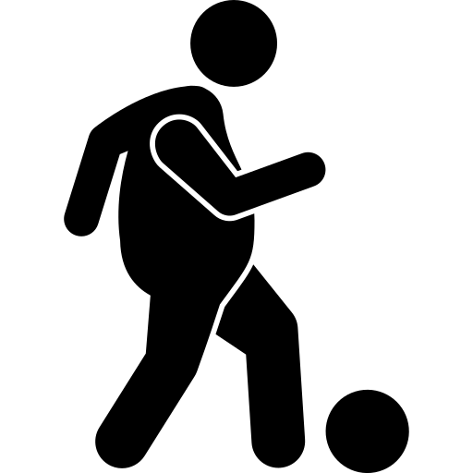

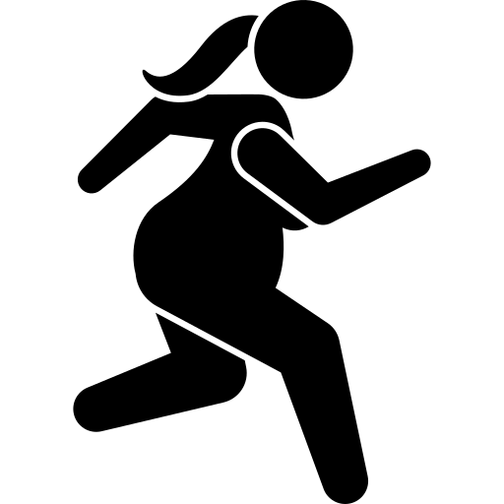

Sport England’s National headline
Long-term increase in activity levels positive but further action needed to tackle inequalities*
Active Lives Adults Survey 2022-23
In a nutshell, there are “two million more adults getting active on a regular basis through sport and physical activity than in 2016*”
But the news isn’t so positive for some demographic groups where inequalities continue to widen
*Source: sportengland.org/news-and-inspiration, published on 25th April 2024

Slide 3
Inequalities in our area
Inactivity in the least affluent households remains high
(NS SeC 6-8)
The gender inequality gap has narrowed over time
Adults with a limiting illness or disability are nearly twice as likely to be inactive

Slide 4
24%
122,000

Slide 5

Almost a quarter of our community are inactive

Slide 6
75,000
(15%)
There are
42,000
A people missing the intensity
8%)
There are
5,000
A people not active for long enough
(1%)
Notes:
No activity at all – doing nothing
Missing the intensity – light only activity only
Not active for long enough – doing 1-29 minutes of activity

Slide 7
Our least affluent households are twice as likely to be inactive (NS SeC 6-8)
There is a clear and growing inequality gap between our least and most affluent households

Slide 8

Asian communities experience higher levels of inactivity

Slide 9
Adults with a limiting illness or disability are almost twice as likely to be inactive
The inequality gap persists but has narrowed over time
Notes:
• Inactivity rates for those with a limiting illness peaked during the pre-pandemic period but have since improved. But there is still a big gap
• Post-pandemic recovery has been more pronounced for those with a limiting illness, contributing to the narrowing inequality gap.
• Worcestershire's inactivity rate for adults with a limiting illness (37%) is lower than the national rate (41%).

Slide 10
The gender inequality gap has narrowed over time
Notes:
Both men's and women's inactivity rates have fluctuated over time, with the gender gap narrowing in recent years

Slide 11
Inactivity increases sharply for adults over the age of 75

Slide 12
Higher inactivity levels are observed at both ends of the age spectrum for both genders

Slide 13
(32%)
2 in 10
(22%)

Slide 15
Includes walking as a way to get from one place to another, such as the shops work or visiting friends*
Includes team, water, combat and winter sports, swimming, athletics, golf, horse riding and gymnastics
Includes all other types of walking, dog walking, rambling and Nordic walking or just going for a stroll*
Includes gym activities (fitness machines and classes), weights, boxing and interval sessions
Gardening is included in this section
Includes leisure and travel, track, road and mountain biking or racing, exercise bike or cycle class
Covers all types of dance including artistic and creative dance (ballroom, ballet, contemporary etc)

Slide 16
Average overall minutes per person per week
Activity minutes have rebounded to pre-pandemic levels
Notes:
Locally, people spend more time being active compared to the national average

Slide 17

What does activity look like where we live?
Most our active minutes come from walking
All dance
People spend more time doing traditional sports than any other activity (second to walking for leisure)
Walking for leisure accounts for almost a third of all physical activity
Gardening
Walking for travel accounts for 13% of minutes in Worcestershire but 18% nationally
Fitness activities
All cycling

Slide 18
Appendix

Slide 19
 | 15-16 | 16-17 | 17-18 | 18-19 | 19-20 | 20-21 | 21-22 | 22-23
All adults (aged 16+) | 2,980 | 2,956 | 3,061 | 2,957 | 2,973 | 3,021 | 2,997 | 2,937
NS SEC 1-2 | 1,411 | 1,484 | 1,449 | 1,452 | 1,421 | 1,473 | 1,501 | 1,485
NS SEC 3-5 | 695 | 704 | 724 | 712 | 698 | 681 | 622 | 605
NS SEC 6-8 | 296 | 303 | 348 | 286 | 338 | 311 | 323 | 256
16-34 | 469 | 456 | 468 | 474 | 500 | 452 | 480 | 434
35-54 | 908 | 928 | 954 | 954 | 904 | 926 | 845 | 834
55-74 | 1,231 | 1,230 | 1,265 | 1,176 | 1,207 | 1,235 | 1,289 | 1,232
75+ | 351 | 321 | 353 | 322 | 339 | 389 | 367 | 414
Male | 1,302 | 1,314 | 1,339 | 1,319 | 1,326 | 1,351 | 1,317 | 1,279
Female | 1,670 | 1,639 | 1,713 | 1,622 | 1,634 | 1,657 | 1,668 | 1,642
No limiting illness | 2,305 | 2,310 | 2,364 | 2,270 | 2,288 | 2,306 | 2,271 | 2,231
Limiting illness | 492 | 483 | 526 | 518 | 534 | 540 | 574 | 564
Working full or part time | 1,509 | 1,580 | 1,626 | 1,608 | 1,602 | 1,622 | 1,570 | 1,534
Unemployed | 61 | 69 | 58 | 56 | 80 | 79 | 74 | 49
Not working | 1,140 | 1,091 | 1,151 | 1,059 | 1,061 | 1,134 | 1,146 | 1,136
Student full or part time | 96 | 75 | 87 | 74 | 85 | 65 | 80 | 69
White Other | 76 | 72 | 112 | 88 | 101 | 118 | 126 | 97
Asian | 34 | 33 | 26 | 40 | 34 | 38 | 42 | 54
Black | 9 | 6 | 11 | 11 | 11 | 18 | 14 | 14
Mixed | 14 | 14 | 24 | 22 | 29 | 22 | 28 | 25
Other ethnic group | 10 | 7 | 9 | 10 | 5 | 8 | 4 | 10
White British | 2,766 | 2,757 | 2,779 | 2,700 | 2,722 | 2,753 | 2,712 | 2,667
Minority ethnic group | 143 | 132 | 182 | 171 | 180 | 204 | 214 | 200

Slide 20
 | Worcestershire | England
No limiting illness | 79.7% | 80.2%
Limiting illness | 20.3% | 19.8%
16-34 years | 20.7% | 24.2%
35-54 years | 25.4% | 26.4%
55-74 years | 25.8% | 22.4%
75+ years | 10.7% | 8.6%
NS SeC 1-2 | 34.9% | 33.2%
NS SeC 3-5 | 29.1% | 27.4%
NS SeC 6-8 | 30.6% | 31.8%
Asian | 2.8% | 9.0%
Black | 0.7% | 3.9%
Mixed | 1.2% | 2.0%
White British | 89.6% | 75.1%
White Other | 5.2% | 7.9%
Working full or part time | 57.1% | 57.0%
Not working | 36.6% | 34.3%
Census provides an insight into the demographic makeup in our area compared to England
Notes:
Worcestershire England
Male 48.5% 48.4%
Female 51.5% 51.6%
0-15 17.3% 18.6%
NS SeC 9 5.4% 7.7%
Unemployed 2.4% 2.9%
Student 4.0% 5.8%

Slide 21
500,000
220,000
50,000
7%
18%
59%
Notes:
England
Population 46,101,000 7% growth
55+ 17,460,000 18% growth
MEG 11,450,000 41% growth

Slide 23
Notes:
22-23 inactive population
2021 census population
Rounded to 1000

Slide 24
There are some stark inequalities
in inactivity rates amongst our population

Slide 25
Most inactive people do no physical activity at all (nothing)

Slide 26
Some of our areas are more likely to experience inactivity than others

Slide 27
Source: sportengland.org/news-and-inspiration, published on 25th April 2024

Slide 28
Source: Sport England Active Lives Survey 2022-23 Report

Slide 29
Acknowledgements
This pack has been created by Press Red
We have leveraged the power of AI to assist in crafting the narrative for this presentation, ensuring consistency in language and style
The AI-generated content has been carefully reviewed and curated by our team
Icons made by Leremy from www.flaticon.com
For further information please contact us at martin@pressred.co.uk or liz@pressred.co.uk

