Slide 1

An insight into adult physical activity behaviour in
Herefordshire

Slide 2


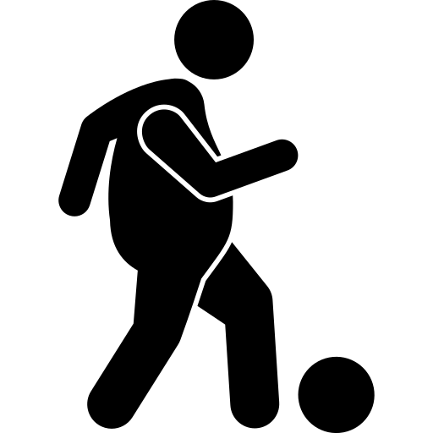
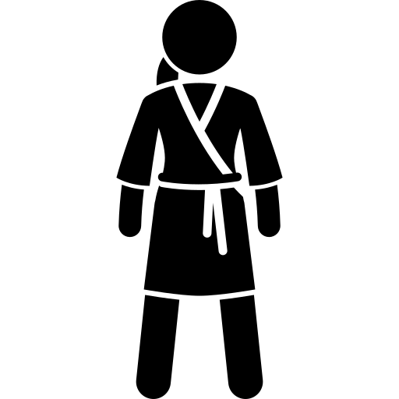
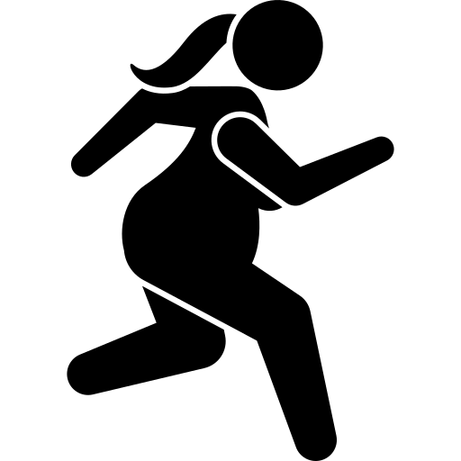

Sport England’s National headline
Long-term increase in activity levels positive but further action needed to tackle inequalities*
Active Lives Adults Survey 2022-23
In a nutshell, there are “two million more adults getting active on a regular basis through sport and physical activity than in 2016*”
But the news isn’t so positive for some demographic groups where inequalities continue to widen
*Source: sportengland.org/news-and-inspiration, published on 25th April 2024

Slide 3
24%
38,000

Slide 4

Almost a quarter of our community are inactive
Notes:
Herefordshire's inactivity levels have improved since 2015–16

Slide 5
21,000
(13%)
There are
15,000
A people missing the intensity
10%)
There are
2,000
A people not active for long enough
(1%)
Notes:
No activity at all – doing nothing
Missing the intensity – light only activity only
Not active for long enough – doing 1-29 minutes of activity

Slide 6
Adults with a limiting illness or disability are more than twice as likely to be inactive
The inequality gap persists

Slide 7
The gender inequality gap has narrowed over time
Women's inactivity rates have fallen while men's have risen

Slide 8
Inactivity increases sharply over the age of 75
Notes:
Compared to England, Herefordshire CC has lower inactivity levels for adults aged 16-74, but higher levels for those aged 75 and over (58% vs 45%)

Slide 10
Includes walking as a way to get from one place to another, such as the shops work or visiting friends*
Includes team, water, combat and winter sports, swimming, athletics, golf, horse riding and gymnastics
Includes all other types of walking, dog walking, rambling and Nordic walking or just going for a stroll*
Includes gym activities (fitness machines and classes), weights, boxing and interval sessions
Gardening is included in this section
Includes leisure and travel, track, road and mountain biking or racing, exercise bike or cycle class
Covers all types of dance including artistic and creative dance (ballroom, ballet, contemporary etc)

Slide 11
Average overall minutes per person per week
Activity minutes fluctuate year on year

Slide 12

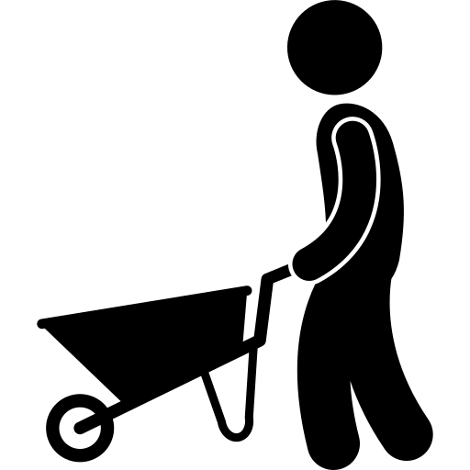
What does activity look like where we live?
Most of our active minutes come from walking
All dance
People spend more time doing traditional sports than any other activity (second to walking for leisure)
Walking for leisure now accounts for almost a third of all physical activity
Gardening contributes a comparatively high proportion of active minutes to our overall active time
Walking for travel
Fitness activities
All cycling

Slide 13
Appendix

Slide 14
 | 15-16 | 16-17 | 17-18 | 18-19 | 19-20 | 20-21 | 21-22 | 22-23
All adults (aged 16+) | 496 | 484 | 497 | 484 | 503 | 493 | 497 | 522
NS SEC 1-2 | 206 | 214 | 228 | 233 | 235 | 226 | 208 | 251
NS SEC 3-5 | 120 | 122 | 132 | 127 | 122 | 111 | 112 | 118
NS SEC 6-8 | 47 | 40 | 38 | 45 | 51 | 54 | 59 | 45
16-34 | 73 | 82 | 67 | 77 | 56 | 51 | 64 | 71
35-54 | 139 | 126 | 126 | 138 | 131 | 113 | 124 | 150
55-74 | 199 | 196 | 228 | 209 | 249 | 249 | 217 | 229
75+ | 76 | 75 | 70 | 59 | 64 | 79 | 89 | 71
Male | 208 | 203 | 215 | 202 | 222 | 215 | 208 | 216
Female | 286 | 281 | 279 | 281 | 278 | 278 | 286 | 301
No limiting illness | 393 | 360 | 365 | 373 | 376 | 390 | 372 | 386
Limiting illness | 65 | 88 | 103 | 91 | 97 | 76 | 94 | 108
Working full or part time | 246 | 232 | 223 | 260 | 264 | 240 | 245 | 291
Unemployed | 10 | 5 | 9 | 13 | 6 | 9 | 6 | 4
Not working | 188 | 205 | 225 | 180 | 192 | 212 | 206 | 190
Student full or part time | 12 | 13 | 9 | 10 | 10 | 7 | 12 | 17
White Other | 12 | 19 | 12 | 16 | 14 | 23 | 14 | 20
Asian | 1 | 3 | 3 | 2 | 4 | 5 | 6 | 6
Black | 1 | 0 | 1 | 0 | 0 | 0 | 0 | 4
Mixed | 1 | 0 | 1 | 3 | 2 | 3 | 2 | 6
Other ethnic group | 0 | 1 | 0 | 0 | 0 | 0 | 2 | 3
White British | 474 | 446 | 460 | 450 | 467 | 450 | 463 | 469
Minority ethnic group | 15 | 23 | 17 | 21 | 20 | 31 | 24 | 39

Slide 15
 | Herefordshire CC | England
No limiting illness | 78.9% | 80.2%
Limiting illness | 21.1% | 19.8%
16-34 years | 19.0% | 24.2%
35-54 years | 24.0% | 26.4%
55-74 years | 28.7% | 22.4%
75+ years | 12.3% | 8.6%
NS SeC 1-2 | 32.9% | 33.2%
NS SeC 3-5 | 31.4% | 27.4%
NS SeC 6-8 | 31.3% | 31.8%
Asian | 1.1% | 9.0%
Black | 0.3% | 3.9%
Mixed | 0.7% | 2.0%
White British | 91.6% | 75.1%
White Other | 5.8% | 7.9%
Working full or part time | 56.0% | 57.0%
Not working | 38.7% | 34.3%
Census provides an insight into the demographic makeup in our area compared to England
Notes:
Herefordshire CC England
Male 48.5% 48.4%
Female 51.5% 51.6%
0-15 16.0% 18.6%
NS SeC 9 4.4% 7.7%
Unemployed 2.1% 2.9%
Student 3.2% 5.8%

Slide 16
160,000
80,000
10,000
3%
18%
41%
Notes:
England
Population 46,101,000 7% growth
55+ 17,460,000 18% growth
MEG 11,450,000 41% growth

Slide 18
Notes:
22-23 inactive population
2021 census population
Rounded to 1000

Slide 19
There are some stark inequalities
in inactivity rates amongst our population

Slide 20
Most inactive people do no physical activity at all (nothing)

Slide 21
Source: sportengland.org/news-and-inspiration, published on 25th April 2024

Slide 22
Source: Sport England Active Lives Survey 2022-23 Report

Slide 23
Acknowledgements
This pack has been created by Press Red
We have leveraged the power of AI to assist in crafting the narrative for this presentation, ensuring consistency in language and style
The AI-generated content has been carefully reviewed and curated by our team
Icons made by Leremy from www.flaticon.com
For further information please contact us at martin@pressred.co.uk or liz@pressred.co.uk

